Slide 1
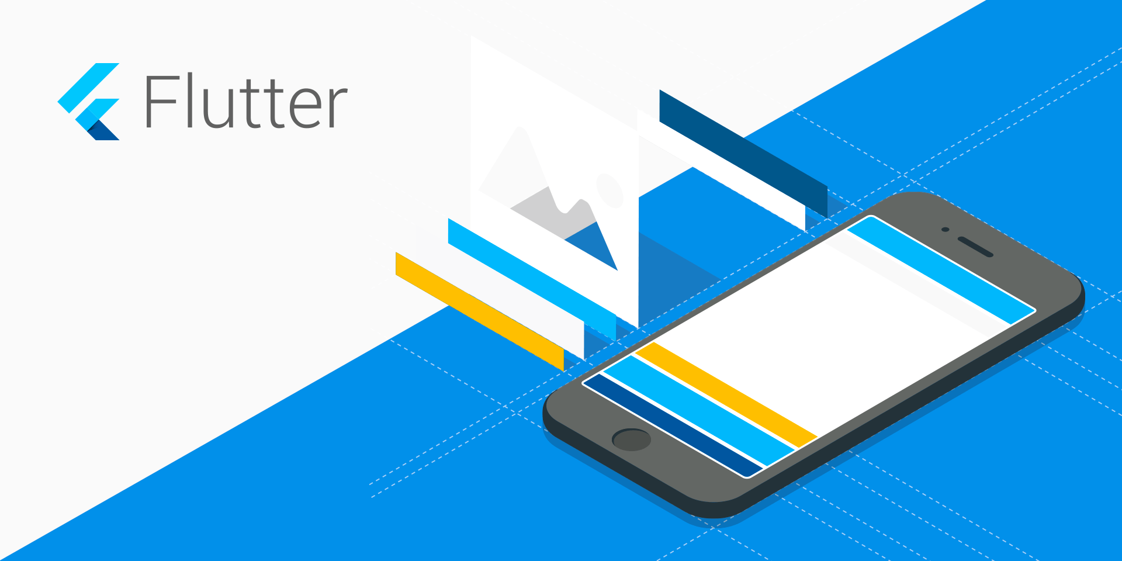
Building Cross-Platform Application using Flutter

Slide 2
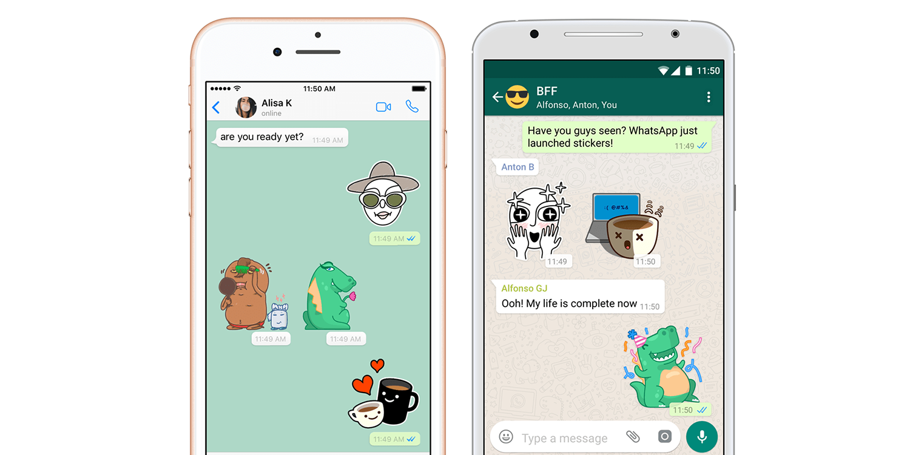
What is Flutter?
Flutter is Mobile Application Development SDK by Google to build native application using single code base.

Slide 3
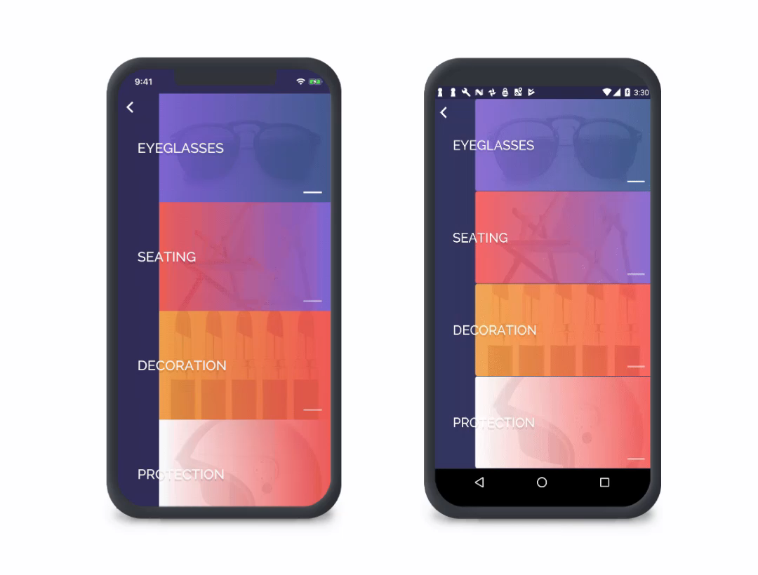
Application Developed Using Flutter
iOS Device
Android Device

Slide 4
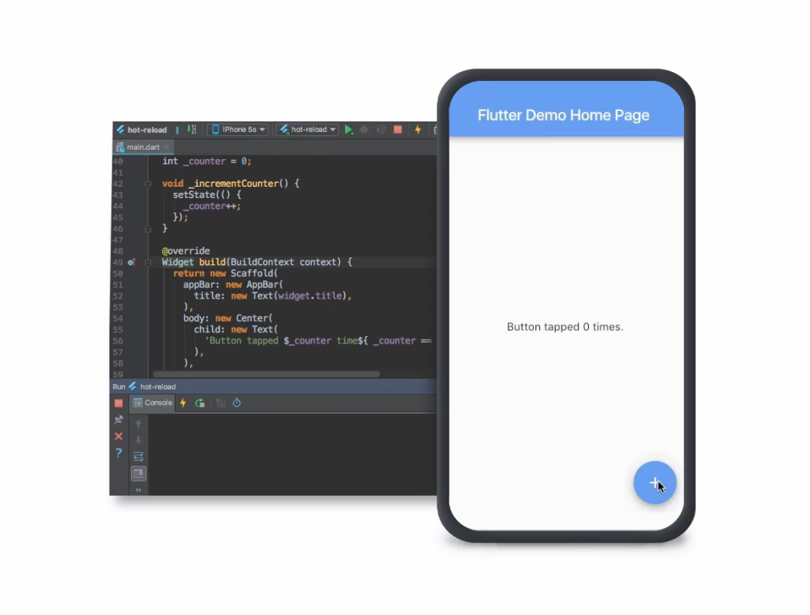
Why you should use Flutter? Drop this Question
Advantages
Hot Reload

Slide 5
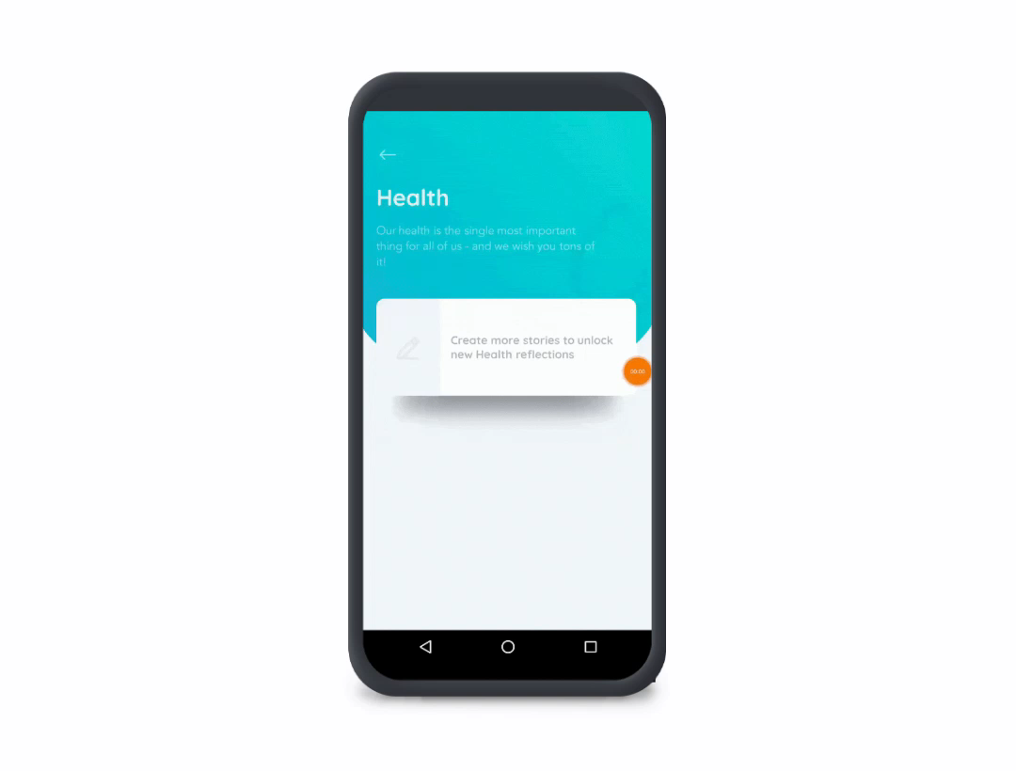
Combination of Material Theme & Cupertino Theme

Slide 6
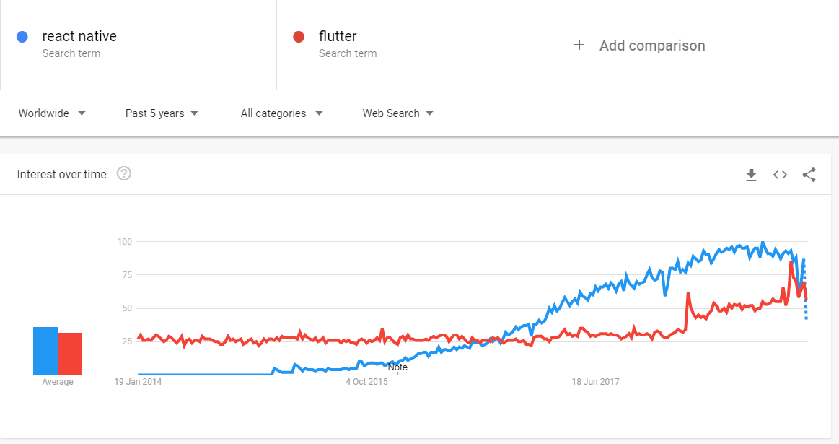
Other Advantages
Native Performance
Primary SDK to develop apps for Fuchsia OS.
Flare + Flutter, integrate beautiful vector animations.
Faster rendering than React Native due to use of low level api’s and flutter rendering pipeline.

Slide 7
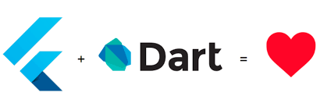
Flutter Dart
Easy to learn
JIT + AOT (Ahead Of Time Compilation)
A good garbage Collector
Optionally Typed
Object Oriented
Free and Open Source

Slide 8
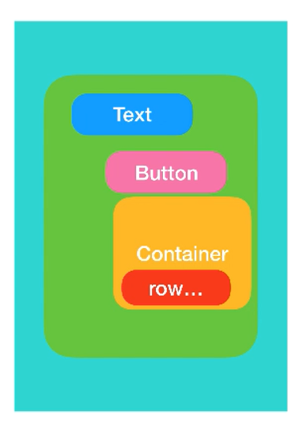
Basics Of Flutter
Widgets are basic building block of the Flutter.

Slide 9
Types Of Widget
Stateless Widget
Stateless Widget doesn’t have mutable state. It is only drawn once during the lifecycle of that page.
Class in Flutter: StatelessWidget class

Slide 10
Stateful Widget
Stateful Widget has mutable state. The widgets are redrawn to show the UI changes on the screen using setState() function.
Floating Action Button
setState()
Button Pressed
Redraw the Widgets
counter++
Stores State in State Object

Slide 11
BASIC WIDGETS
Container Widget
The container Widget can be used to provide the padding, width, height and other constraints to the child widget.
Text Widget
The Text widget displays a string of text with single style.
Row Widget
A widget that displays its children in a horizontal array.
Column Widget
A widget that displays its children in a vertical array.

Slide 12
ListView Widget
A scrollable list of widgets arranged linearly. ListView is the most commonly used scrolling widget. It displays its children one after another in the scroll direction.
Scroll Physics
1. BouncingScrollPhysics
2. ClampingScrollPhysics
3. FixedExtentScrollPhysics

Slide 13
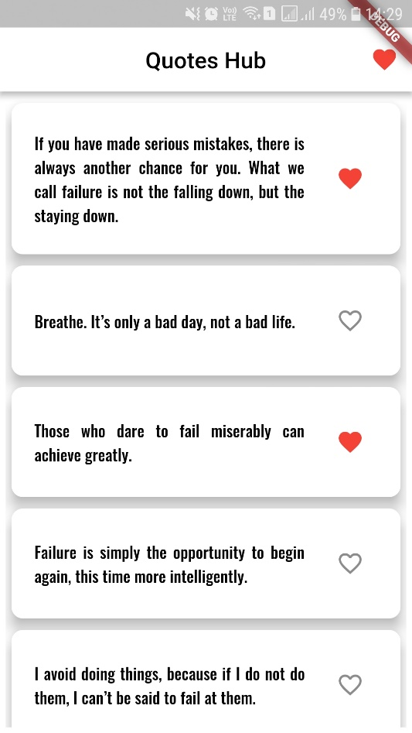
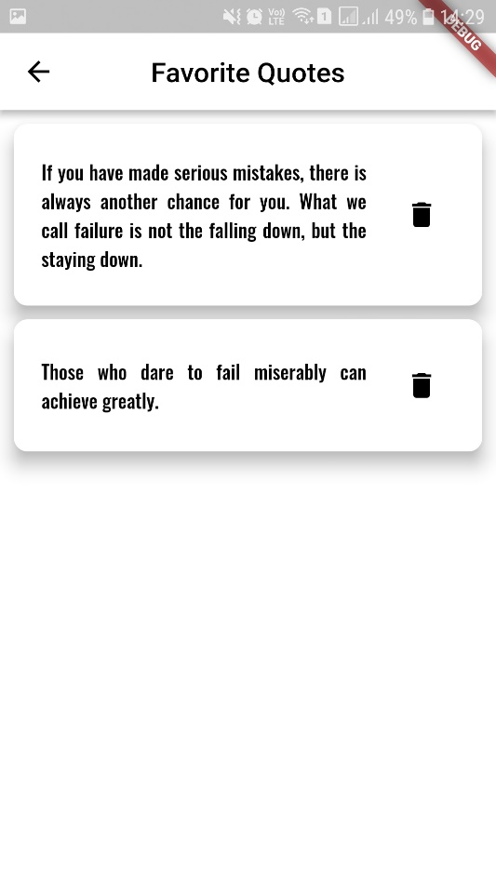
Time to get your hands dirty

Slide 14
Thank You

